Slide 1
Functions of the Text Analysis Tools
Part 3 of 3: General Tools
May 2017, D. Graham Andrews

Slide 2
Audience and Purpose
Audience: Managers and new users
This slide deck is aimed at people who want to understand what this toolset does without knowing exactly how to use it.

Slide 3
WORD COUNTING TOOLS
Word counting analyzes the frequency of terms to draw conclusions about the underlying documents
Simple word counting addresses questions like these:
In how many of the sections does an author discuss gender?
Which of these articles mentions vaccination?
Complex word counting with a computer can do more…
The difference between basic and complex is whether humans can reasonably do it.

Slide 4
COMPLEX WORDCOUNTING
Complex word counting can deal with huge numbers of documents, and relative word proximity
Often multiple documents are talking about the same thing. We can look at the entire project as a coherent whole, not as separate documents.
Applications
Completion reports
Status reports
Emails
Word proximity is challenging for humans: “What words are most commonly mentioned with the one I care about?”
We may want to know which words are the most common ones after “stop words” (the, a, to, of) are dropped

Slide 5
WHAT DOES THE PROCESS LOOK LIKE IN CODE?
Step # | Task | Software calls to do it
1 | Load the software, expand memory | library(epartexttools) options(java.parameters = "-Xmx4g")
2 | Download all documents to a folder | setwd(“c:\research_grants")
3 | Take pictures of each page, infer text from the images | setwd(OCR_DOCS(research_grants))
4 | Load all documents into a “corpus” | wellcome_corpus<-allDocs(directory="OCR_Results",SkiponError=FALSE,gen_pdf_tools=TRUE)
5 | Cut punctuation/whitespace/stop words | wellcome_corpus_clean<-doc_clean_process(wellcome_corpus)
6 | Build matrix of word frequencies | tdm<-TermDocumentMatrix(wellcome_corpus_clean) %>% removeSparseTerms(.,.8)
7 | From here we can generate results like a chart or a table as needed | EXAMPLE: wordcount_table(c(term1, term2), tdm,wellcome_corpus)

Slide 6
Terminology
Term | Definition
Corpus | A whole set of documents grouped around a concept, for example a grant, or grants on a topic. Any non-random collection of documents can be a corpus
Term document matrix | The result of splitting all the words in a corpus into a matrix of (at minimum) document names along one axis and terms in those docs on the other axis
Sparse Term | A term that exists in only one document in the matrix, most of it’s column is empty cells
Stop words | Small words with grammatical but not technical meaning- “and, if, who, a, then, etc”

Slide 7
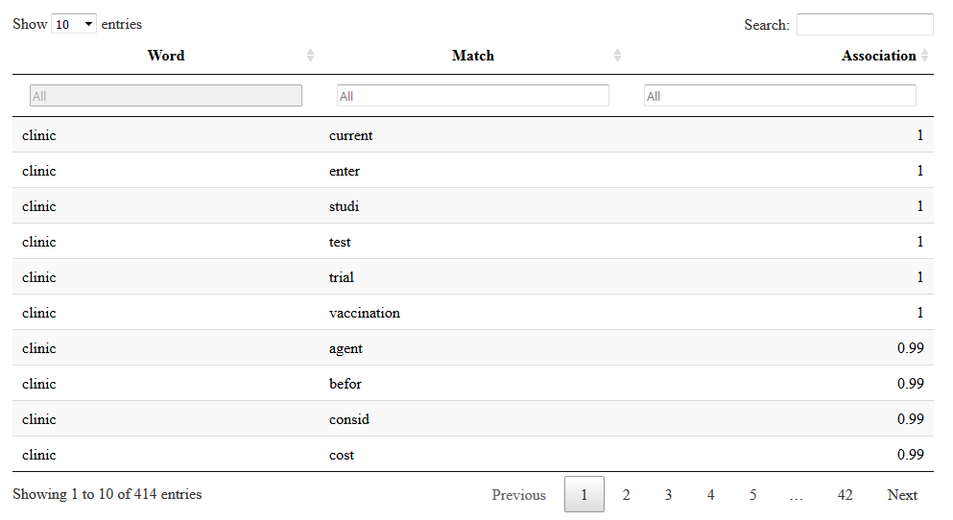
EXAMPLE OUTPUT 1 of 3
A few examples of the kinds of output available…
Which words are strongly associated with “clinic”?

Slide 8
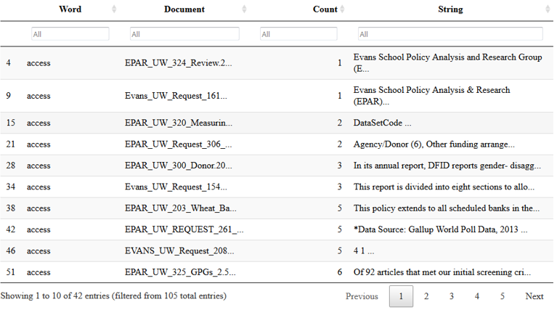
EXAMPLE OUTPUT 2 of 3
A few examples of the kinds of output available…
Which documents mention “access,” in what context, and how often?

Slide 9
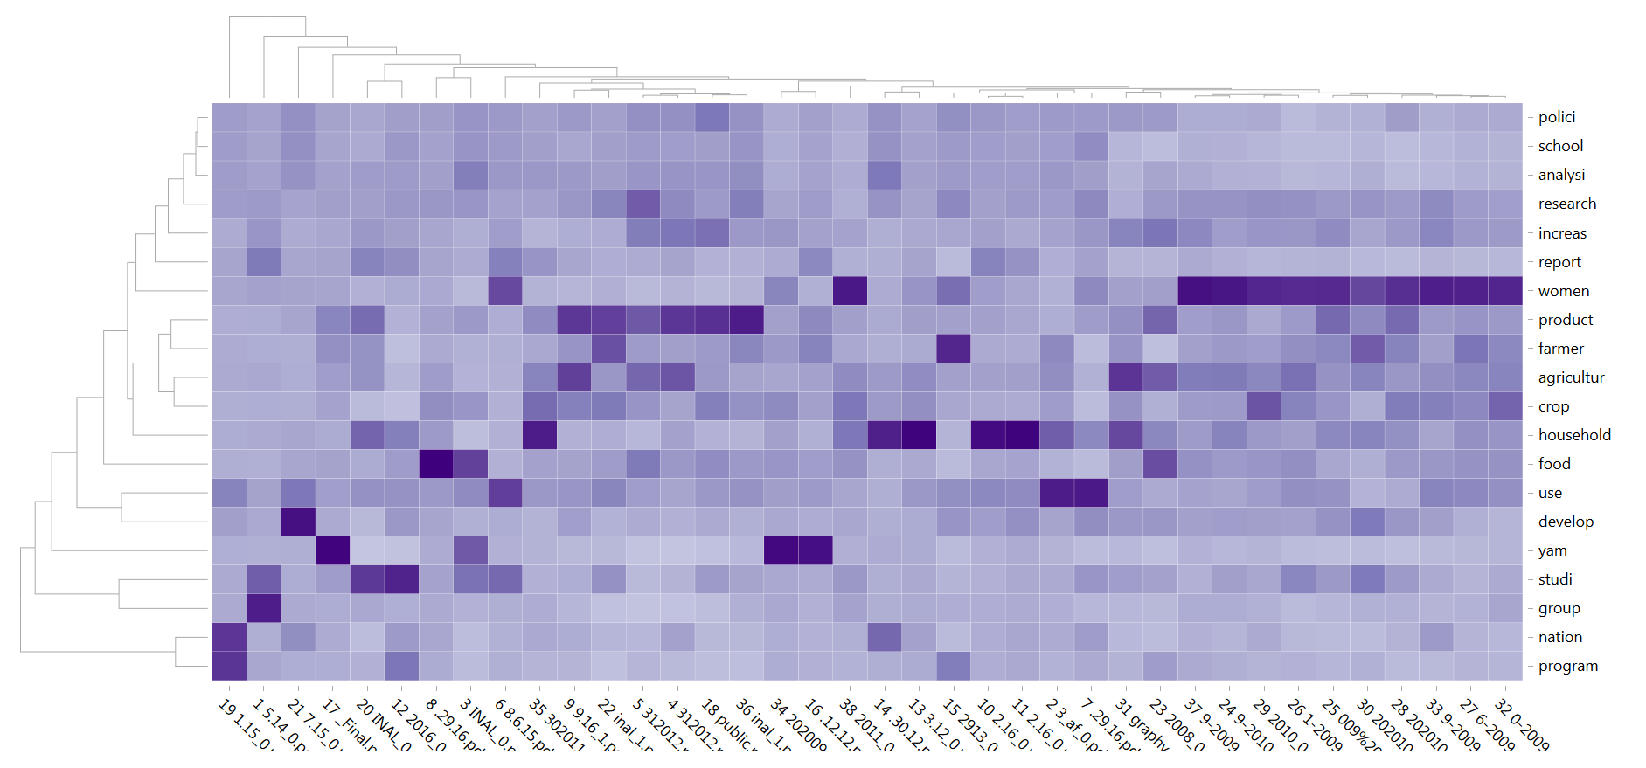
EXAMPLE OUTPUT 3 of 3
A few examples of the kinds of output available…
Of the N most common words in the corpus, how are they distributed across the documents?
(Document names on the X axis, common words on the Y axis)

Slide 10
What other visualizations are available?
We use the D3 library, which can do incredible amounts of things
Have a look a the D3 gallery here – literally hundreds of options
https://github.com/d3/d3/wiki/Gallery

Slide 11
BUGS AND FEATURES STILL NEEDED
At the time of writing, these block us from using the tools for word counting
(Priority: High) Synonym grouping – User ability to list several words (such as “tuberculosis” and “TB”) as identical for wordcounting purposes
(Priority: Medium) Bug in reading .doc files on windows (expected to function on mac/linux today)
(Priority: Medium) Ability to filter out words from the word list
(Priority: Low) Document the different tables and charts available for users
(A full list of known work items can be found here: https://github.com/ryscott5/eparTextTools/issues )

Slide 12
Evans School Policy Analysis & Research Group (EPAR)
Professor C. Leigh Anderson, Principal Investigator
Professor Travis Reynolds, co-Principal Investigator
EPAR uses an innovative student-faculty team model to provide rigorous, applied research and analysis to international development stakeholders. Established in 2008, the EPAR model has since been emulated by other UW schools and programs to further enrich the international development community and enhance student learning.
Please direct comments or questions about this research to Principal Investigators C. Leigh Anderson and Travis Reynolds at
eparinfo@uw.edu.

Slide 13
Functions of the Text Analysis Tools
Part 2 of 3: Word Counting Tools
August 2017, D. Graham Andrews

Slide 14
Topic Modeling
Topic Modeling tries to determine what a group of documents is about
Building on the same functionality as word counting, topic modeling can be done on large sets of documents, bigger and more diverse than humans can reasonably view.
Unlike word counting, topic modeling makes use of the entire grammar of the sentences in a document.
Of course, what constitutes a topic is not clearly defined. Broad topics can be broken down into smaller topics. There is no programmatic solution for this issue.
Instead, we must provide the software with a number of topics to search for. This can require some trial and error.

Slide 15
What does the process look like in code?
Step # | Task | Software calls to do it
1 | Load the software, expand memory | library(epartexttools) options(java.parameters = "-Xmx4g")
2 | Download all documents to a folder | setwd(“c:\research_grants")
3 | Take pictures of each page, infer text from the images | setwd(OCR_DOCS(research_grants))
4 | Load all documents into a “corpus” | wellcome_corpus<-allDocs(directory="OCR_Results",SkiponError=FALSE,gen_pdf_tools=TRUE)
5 | Build a “frame” which marks grammatical structure | topic_frame <- PreTopicFrame2(welcome_corpus, working_folder, dbexists = FALSE, spcy = TRUE)
6 | Build a formula which allows covariates to be added to the topic model | writeFormulaforSTM(topic_frame, research_grants)
7 | Build a topic model (long background process) based on the grammar | runSTM() and status visible with callstm.rout

Slide 16
Terminology
Term | Definition
Corpus | A whole set of documents grouped around a concept, for example a grant, or grants on a topic. Any non-random collection of documents can be a corpus
Frame | A computed variant of a corpus with proper nouns, verb phrases, and other grammatical metadata pulled out into a companion database
Entities | Term used for proper nouns in grammatical structure
Verb-phrase | The part of a sentence containing both the verb and any direct or indirect object

Slide 17
EXAMPLE OUTPUT
A few examples of the kinds of output available…
(a bug is currently blocking us from generating example output)

Slide 18
BUGS AND FEATURES STILL NEEDED
At the time of writing, these block us from using the tools for topic modeling
(Priority: High) rsqLite database does not start on windows
(Priority: High) Documentation required to show people how to use topic modeling
(A full list of known work items can be found here: https://github.com/ryscott5/eparTextTools/issues )

Slide 19
Functions of the Text Analysis Tools
Part 2 of 3: Word Counting Tools
August 2017, D. Graham Andrews

Slide 20
General Toolset
As part of development, we sometimes end up building smaller tools for specific requests, for testing feasability, and for automating tasks. Our package includes tools to:
Search the Pubmed Database with a search term, and return a table of metadata about any results
Find a document ID in pubmed, and return a table of metadata about it.
Search the PubMed database with an ID, and return a list of all PubMed publications which cite that ID.
Create a demonstration user interface for the tools
Download example document files to use with a demo
Transform documents containing html into true raw text files

Slide 21
Location of Each Tool
Step # | Task | Location
1 | PubMed search by ID | /epartexttools/r/pubmedviaRISmed.r
2 | PubMed search by term | /epartexttools/r/pubmedviaRISmed.r
3 | PubMed citations by ID | /epartexttools/r/pubmedviaRISmed.r
4 | Create a user interface for the tools with Shiny | /epartexttools/r/shinyapp/appflow.r
5 | Download example document files to use with a demo | /epartexttools/r/textfunctions.r
7 | Transform documents containing html into true raw text files | /epartexttools/r/tools/tools.r

Slide 22
Example Usage Code for Each Tool
Step # | Task | Software Calls to do it
1 | PubMed search by ID | searchPMIDs(“468397”)
2 | PubMed search by term | searchWordsPubMED(“076438[Grant Number],””)
3 | PubMed citations by ID | getCitations(searchWordsPubMED(“076438[Grant Number]”,””))
4 | Create a user interface for the tools with Shiny | writeShinyFlow(getWD(), “shiny_app_name”)
5 | Download example document files to use with a demo | example_documents()
7 | Transform documents containing html into true raw text files | findHiddenHTML(“folder_name”)

Slide 23
Terminology
Term | Definition
PubMed | A centralized database containing most of the published medical research in the United States
Term document matrix | The result of splitting all the words in a corpus into a matrix of (at minimum) document names along one axis and terms in those docs on the other axis
Sparse Term | A term that exists in only one document in the matrix, most of it’s column is empty cells
Stop words | Small words with grammatical but not technical meaning- “and, if, who, a, then, etc”

Slide 24
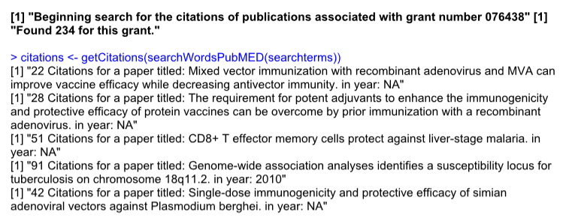
EXAMPLE OUTPUT
An example of the PubMed search output
How many citations did the grant number 076438 create?

Slide 25
BUGS AND FEATURES STILL NEEDED
These are known items still to be worked on for the tools
(Priority: Medium) Test the new findHiddenHTML function on documents from the 10ks
(Priority: Low) Move other tools into the new /tools/folder
(A full list of known work items can be found here: https://github.com/ryscott5/eparTextTools/issues )

Slide 26
Evans School Policy Analysis & Research Group (EPAR)
Professor C. Leigh Anderson, Principal Investigator
Professor Travis Reynolds, co-Principal Investigator
EPAR uses an innovative student-faculty team model to provide rigorous, applied research and analysis to international development stakeholders. Established in 2008, the EPAR model has since been emulated by other UW schools and programs to further enrich the international development community and enhance student learning.
Please direct comments or questions about this research to Principal Investigators C. Leigh Anderson and Travis Reynolds at
eparinfo@uw.edu.

